Slide 1

IOT Smart Wheelchair

Slide 2

Team
Members
Ahmed Rafat AbdelWahab
Ahmed Elsayed Sabra
Ahmed Awny Ahmed Eldaly
Abdel Rahman Hemdan Abdel Rahman
Marwa Ashraf Elshahat
Marwa Mohamed Galal

Slide 3
Introduction
Our Project “Wheelchair” aims to help paralysis patients that have difficulty in walking ,The Smart Wheelchair helps them in self-movement without help , The Wheelchair is equipped with GPS and Wi-Fi to make the patient in permanent contact with the hospital for taking care of him and saving him , if the patients is in a danger.
The patient controls the movement of the wheelchair via a joystick
or an Android Application on his mobile phone or any device that
calls Android.

Slide 4
Motivation
The motivation that drove us to do this project is to help people with special needs as well as the elderly who have become unable to move. So we made this chair in order to make them able to move more easily. It also provides them with some services as it keeps the patient in constant contact with the hospital so that help is sent to him whenever he needs it.
The chair is attached to many sensors that transmit information about the patient to the hospital. It also contains GPS to make the hospital aware of the patient’s whereabouts, in order to send him help where he was.

Slide 5
Project content
The Project is divided into three branches
Hardware (Arduino)
Android Application
Web Service

Slide 6
Android Application
2
Controlling

Slide 7
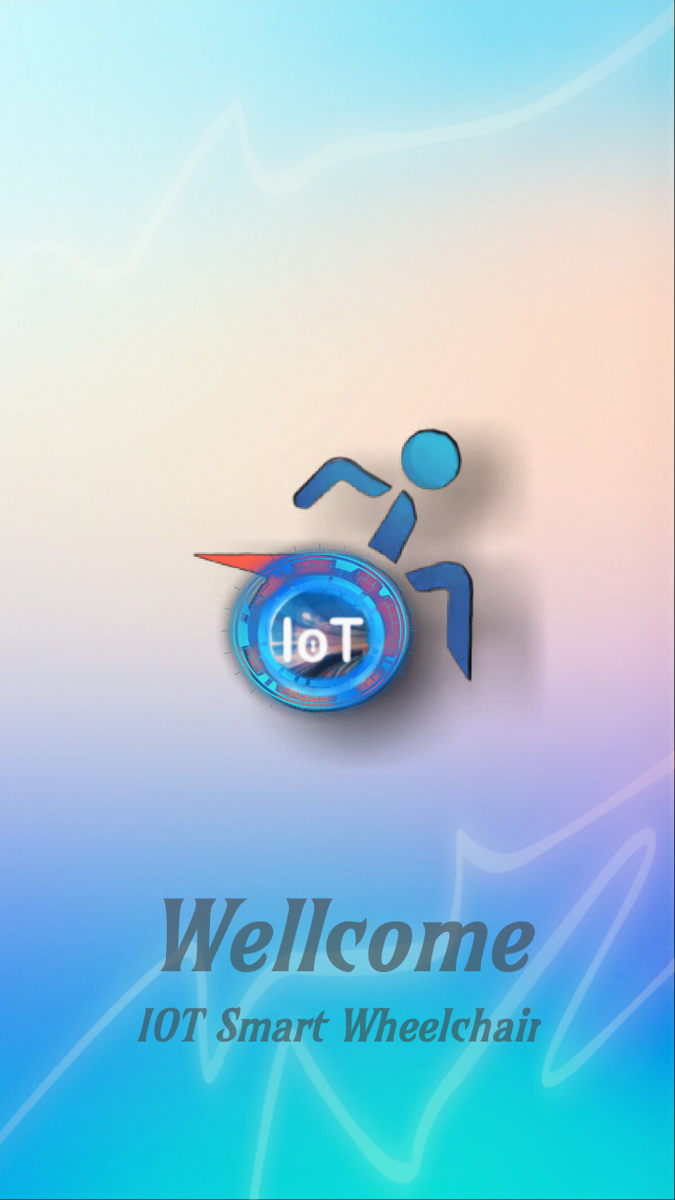
.
Android Application
The purpose of the application is to control the chair
by connecting to Bluetooth via the Bluetooth module HC 05
Installed in the Arduino device that controls the chair by
application
The main features of the application evolve around
control by choosing the appropriate control:
Direction
Voice
.

Slide 8
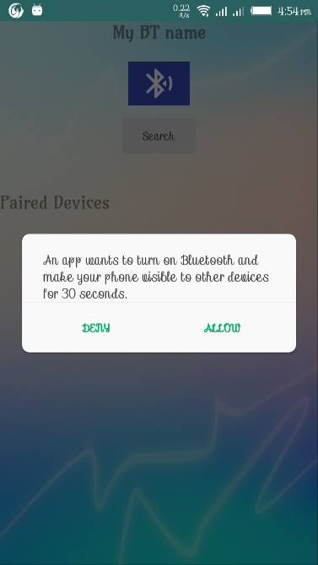
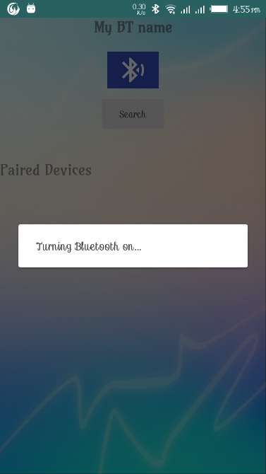
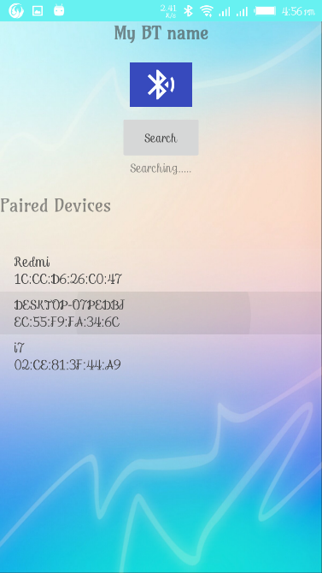
.
Android Application
A Request for Permission indicates that the Bluetooth
is turned on in the Android device, after the start of the
operation, a Search for devices starts after what I do,
and the paired devices appear.
Never connect to the Bluetooth Module in the Wheelchair.
.

Slide 9
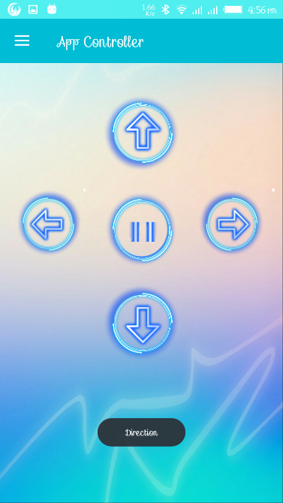
.
Direction Controls
The Direction page has 5 Button which are the 4 directions
(Forward) - (Reserve) - (Right) - (Left).
In addition to the button for the stop of the chair
The chair will move via the command to send a message
to the Bluetooth device, a message in it
.

Slide 10
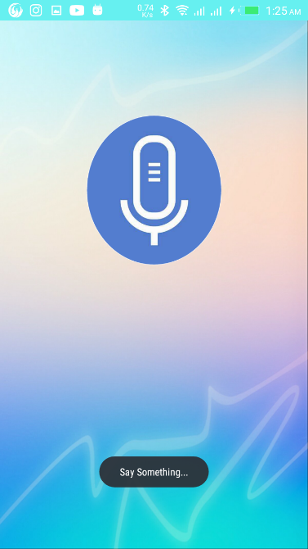
.
Voice Controls
Here is the idea in controlling Speech to Text,
which is the conversion of voice to speech by controlling
the command, and a message is sent to the Bluetooth device,
a message in it when speaking a word from:
.

Slide 11
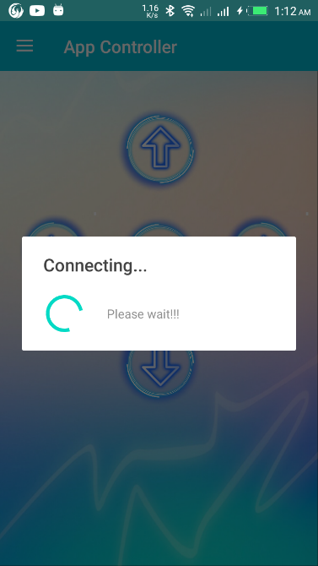
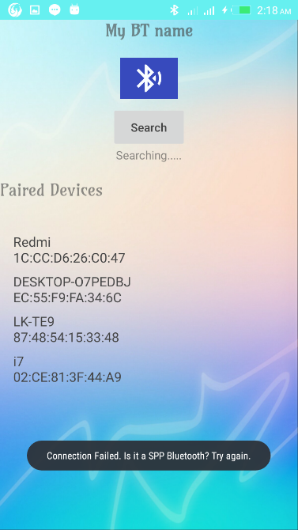
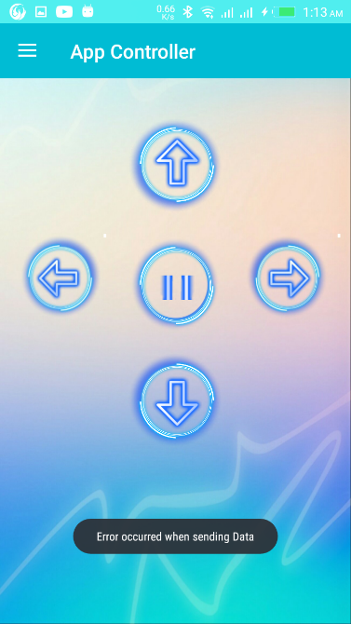
.
Failure Connection
When failure of connection happens during controlling , It returns and reconnect again
.

Slide 12
Monitoring Patient Health status, The Wheelchair balance and asking for help in case of The Patient get a dangerous event

Slide 13
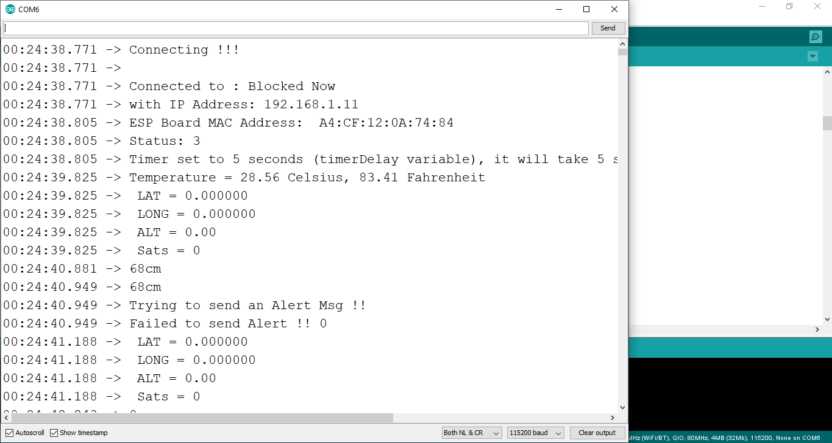
Establishing Wireless Network Connection
Set the network- SSID and password an Trying to connect to network.
1. If connection failed , try again and at the same time start read
sensors’ data. 2. If connection success start read sensors’ data

Slide 14
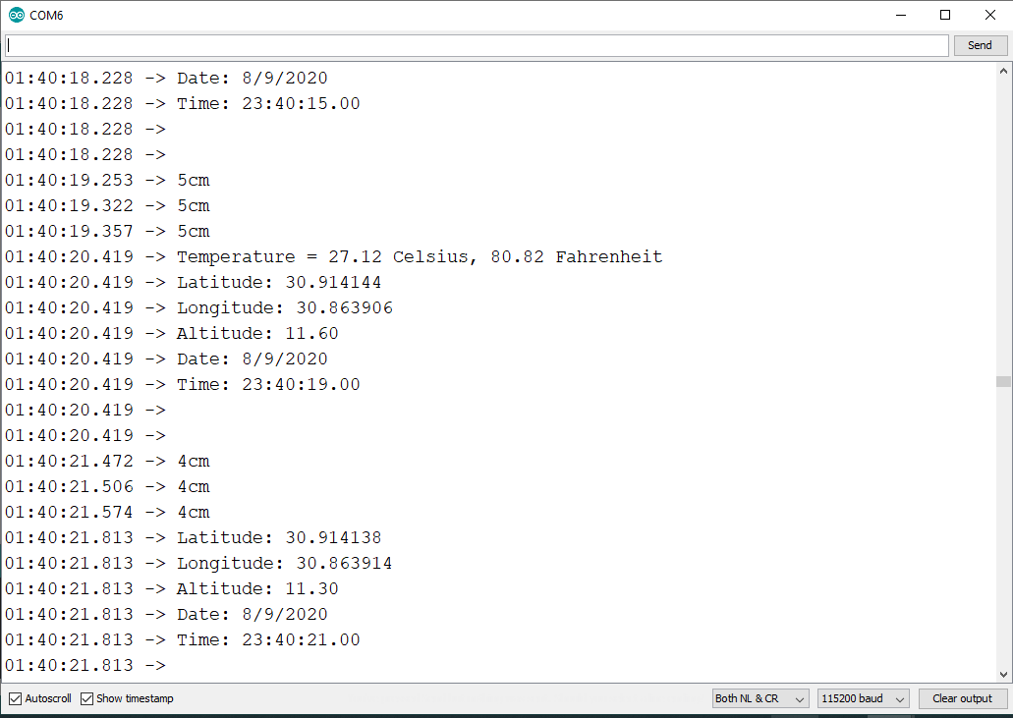
Establishing Wireless Network Connection
Checking patient health by reading data coming from sensors connected to the Wheel chair:

Slide 15
Reading distance from ultrasonic sensor to check the balance of The Wheelchair and measuring his/her Temperature at the same time
We have two cases could happen :
First case: If the wheelchair is balanced and the patient temperature is normal so sensors keep monitoring patient health and wheelchair balance .
Second case: if patient’s temperature is up normal or the wheelchair not balanced or both of them then we need to ask for help from the hospital by sending an alert massage to the hospital’s system which contain patient’s last measured sensors’ data and her/his location

Slide 16
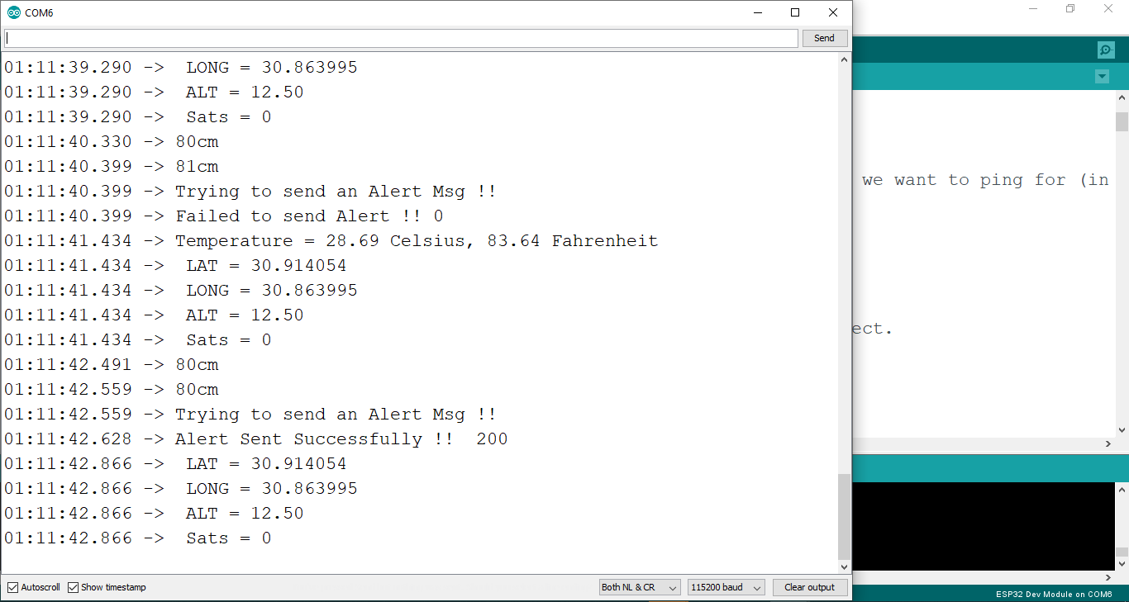
Sending an alert message to
The Hospital System

Slide 17
Web Service
5
Web Service & Dashboard

Slide 18
Web Service
Web service is a medium to propagate communication between the client and server applications on the World Wide Web.
Web services provide a common platform that allows multiple applications built on various programming languages to have the ability to communicate with each other.

Slide 19

000webhost server
We uploaded web service files and created database on 000webhost server.

Slide 20
Web Service
The web service receives the patient data (Human temperature ,latitude, longitude ,time , date) .
Latitude and longitude that are read from GPS are converted to a physical address,
then the patient data is stored in a database table, and show it on a the hospital interface.

Slide 21
Patients table
Patients table has the data that is sent by the patient .
Responded and response time default value is 0 until the interface user confirms that the request is sent.

Slide 22
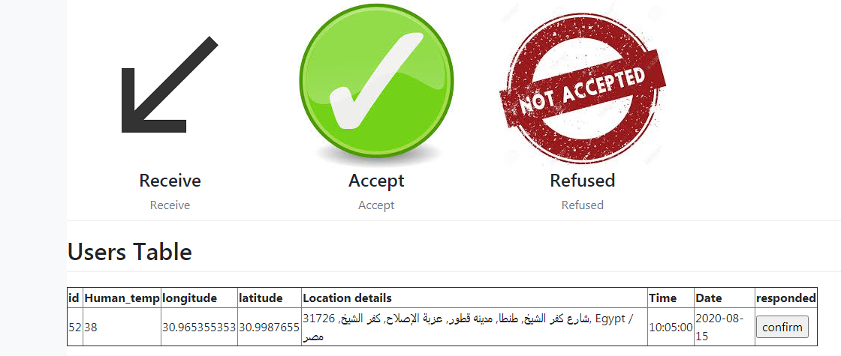
Hospital Interface
Patient data is sent from patient database table to The hospital interface table , So that the user can show and handle it .

Slide 23
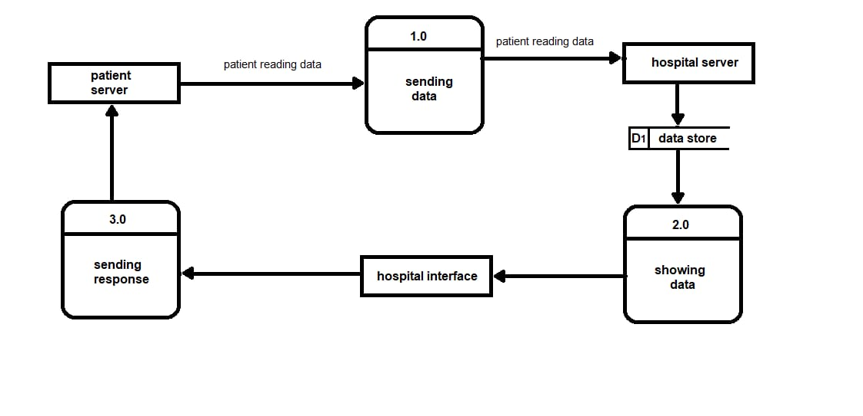
Context diagram

Slide 24
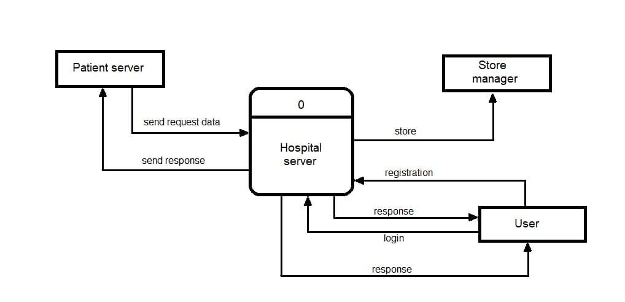
Data Flow diagram

Slide 25
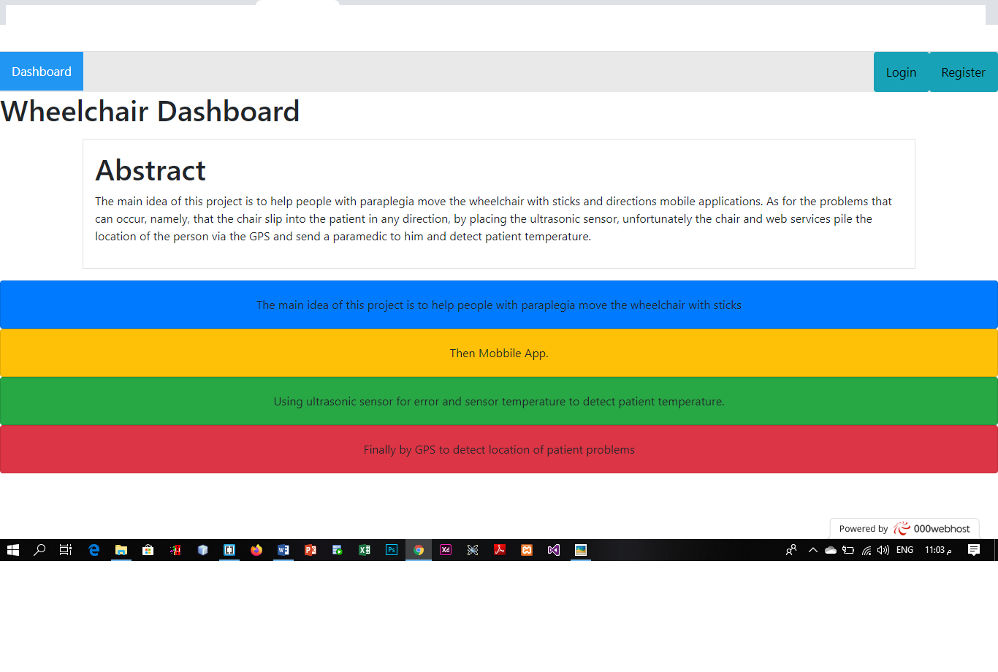
Dashboard
The user of dashboard has to register an account and login to show and handle the dashboard interface.
.

Slide 26
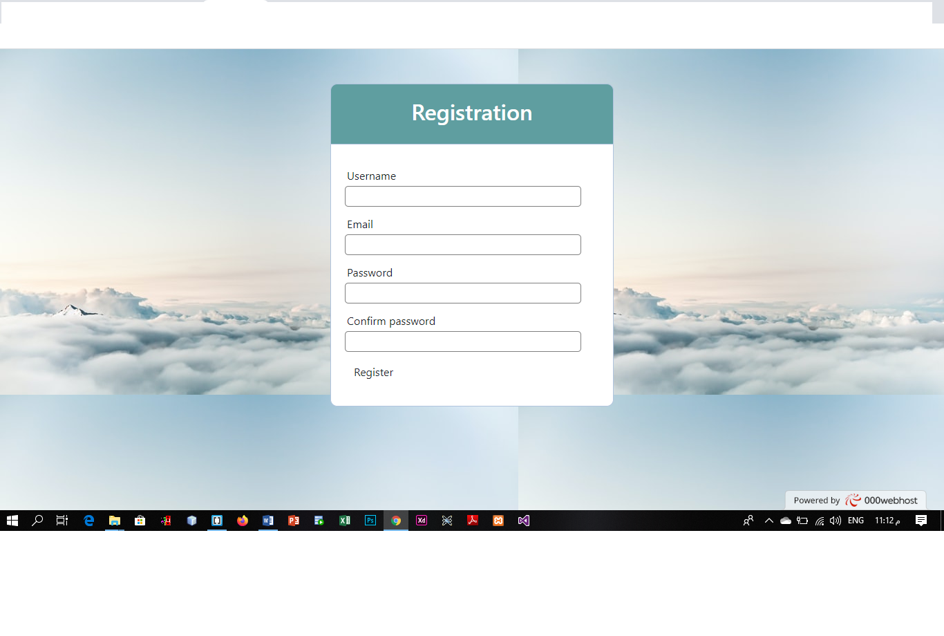
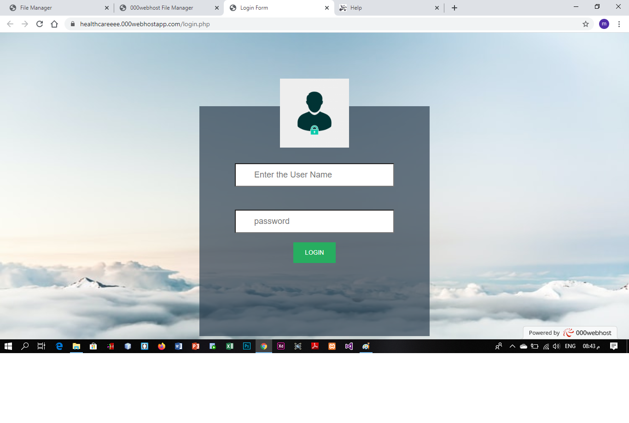
Dashboard
User can Registration/Login.
.

Slide 27
Registration Form
First, The user should register and account , It checks that the email and username are not didn‘t be registered.
.

Slide 28
Login form
The User enter his username and password that he registered by to login in the dashboard interface .
.

Slide 29
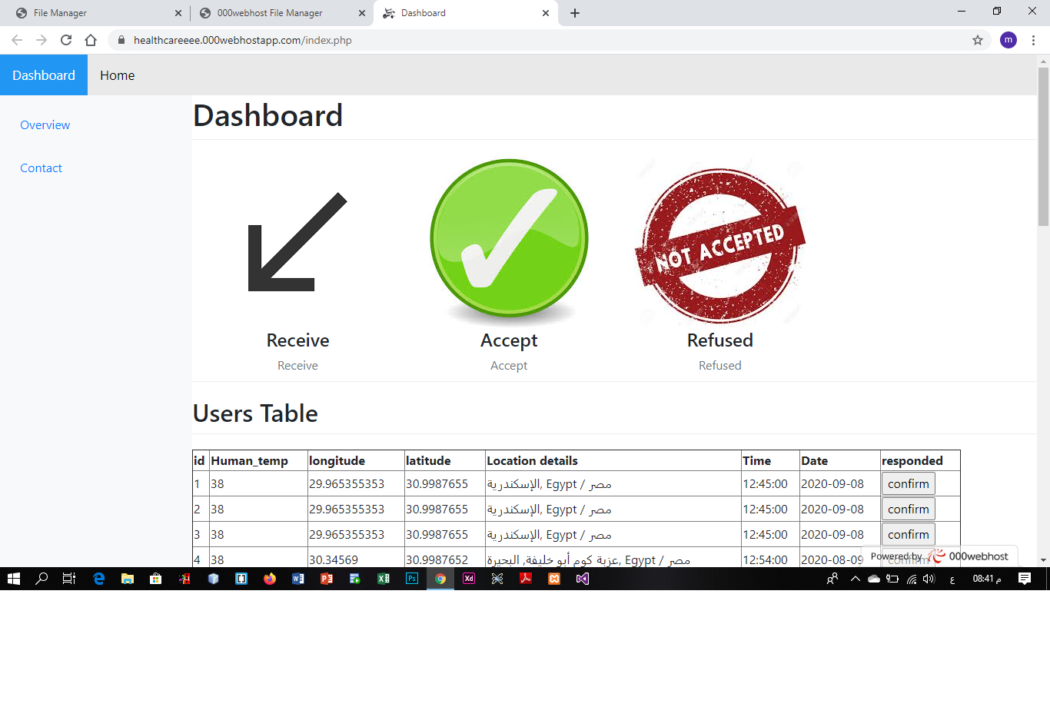
Dashboard
When the user clicks confirm button ,The value of “responded” is converted to 1 , And the value of “response time” is changed to the time of response.
.

Slide 30
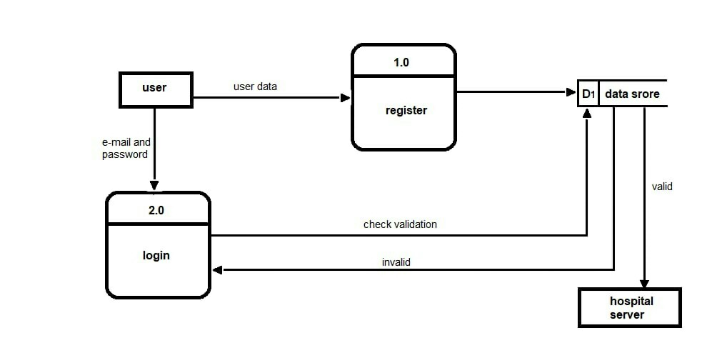
Data Flow diagram (Login)

Slide 31
Tools and Technologies
Software Tools :
Android Studio
Arduino ide
Web host
Hardware Tools :
Arduino. Uno
Hc-05 Bluetooth module
Esp. 32
Neo 6 m v2 GPS
DS18B20 sensor
Ultrasonic sensor
Web Service Tools:
PHP/MySQL
Java script
Css
Html

Slide 32
Future Works
We can add many extensions to our project in future.
In the future, we could make the chair move by the patient's nerve signals.
We can add a sensor to measure the heartbeat.
We can add a sensor to measure the patient's blood pressure.
Adding new features to the project.

Slide 33
Thanks!
Any questions?

